Slide 1
The Belgian National Productivity Board
Catherine Fuss
LIME meeting 2019, Brussels, 15/10/2019

Slide 2
The Belgian NPB
Set up of the Belgian NPB in 2019
Composition : 12 members + secretariat
Organisation and ressources
The NPB annual reports
NPB BEL Composition Organisation and ressources NPB reports

Slide 3
Composition of the Belgian NPB
6 members designated by independent federal institutions
6 members designated by the Regions
Secretariat by the Federal Public Service of Economy
NPB BEL Composition Organisation and ressources NPB reports

Slide 4
Composition of the Belgian NPB
6 members designated by independent federal institutions
Secretariat of Central Economic Council
Luc Denayer (chairman)
Siska Vandecandelare
Federal Plan Bureau
Chantal Kegels
Joost Verlinden
National Bank of Belgium
Tim Hermans
Catherine Fuss
NPB BEL Composition Organisation and ressources NPB reports

Slide 5
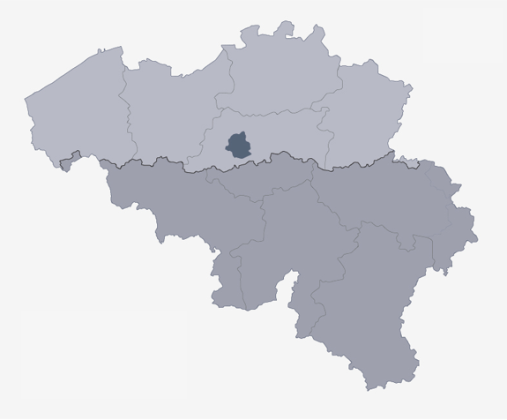
Composition of the Belgian NPB
6 members designated by the Regions
Flemish Region
Joep Konings (KU Leuven)
Caroline Ven (CEO, experience in policy-advise, …)
Walloon Region
Marcus Dejardin (U Namur)
Bernard Jurion (U Liège)
Brussels-Capital Region
Astrid Romain (Brussels Institute for Statistics and Analysis)
Luc Hens (VU Brussels)
NPB BEL Composition Organisation and ressources NPB reports

Slide 6
Organisation and ressources
Independent experts of NPB
independant institutions with experience in economic analysis, research, policy evaluation, …
academics with renowed experience in the field
other experts and practitioners, with experience with policy advise
Communication
NPB reports sent to all governments (federal and federated entities) and the EU Commission
web site (under construction)
NPB BEL Composition Organisation and ressources NPB reports

Slide 7
Data ressources
Macroeconomic data
a.o. national accounts, AMECO, …
Sector-level data
e.g. EU KLEMS
Regional data
a.o. national accounts
Microeconomic data
balance sheet information VAT transactions
international transaction trade data and FDI survey
various surveys: Prodcom, CIS, ad-hoc, …
NPB BEL Composition Organisation and ressources NPB reports

Slide 8
The NPB annual reports
Discussion/approval of annual reports
approved by the NPB
presented to social partners through the CEC, with possibility to append an Opinion
The first report : stylised facts and first discussions
NB: the report will be published in December – still under embargo
Forthcoming reports: drivers of productivity and competitiveness
to be published in September, in line with the European Semester agenda
NPB BEL Composition Organisation and ressources NPB reports

Slide 9
The first Belgian NPB report
Definition of productivity and competitiveness concepts
and relation between the various concepts
Stylised facts on the evolution of productivity in Belgium
in light of international comparison, sector developments, and firm-level dynamics
considering the role of capital deepening, sector composition, and globalisation
Drivers of productivity and competitiveness
discussion of potential drivers and their interactions
NPB BEL Composition Organisation and ressources NPB reports

